Slide 1
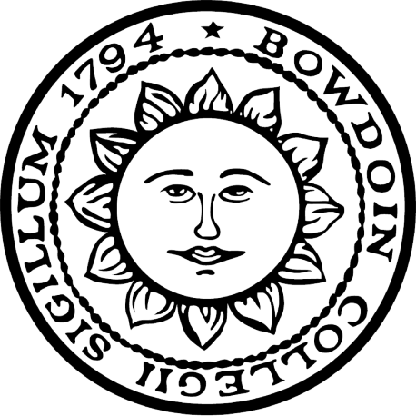


Carboxylic Acid Activation: Investigation of an Enantioselective Iodolactonization of 1,4-Cyclohexadienes
Hyungyu Lee†, Matthew T. Knowe‡, Jeffrey N. Johnston*
†Bowdoin College, Department of Chemistry, Brunswick, ME 04011
‡*Vanderbilt University, Department of Chemistry and Institute of Chemical Biology, Nashville, TN 37235
Abstract
Previous Work
Catalytic Enantioselective Iodolactonization
A longstanding challenge in asymmetric catalysis is the activation of carboxylic acids, especially as nucleophiles in addition reactions. Carboxylic acids are ubiquitous in nature, rendering them attractive substrates. Our initial investigations of bis(amidine)-based chiral proton complexes in iodolactonizations established that bifunctional activation of an iodonium source and the carboxylic acid could lead to high enantioselection. This work evaluated a carboxylic acid substrate constrained to monofunctional activation, owing to the bridged bicyclic transition state required for cyclization. We report preliminary findings for the enantioselective iodolactonization of 1,4-cyclohexadienes using bis(amidine)-based catalysts.
Figure 3: 5-exo enantioselective iodolactonization of cyclopentene carboxylic acid substrate.
Figure 4: Extension of previous results to 4-exo enantioselective iodolactonization of cyclohexadiene carboxylic acid substrate.
Figure 5: Synthesis of organocatalyst ^{6t}BuStilb(^{p}MeAn)BAM. (N²,N²'-((1R,2R)-1,2-diphenylethane-1,2-diyl)bis(6-(tert-butyl)-N⁴-(p-tolyl)quinoline-2,4-diamine).
Figure 6: Synthesis of cyclohexadiene carboxylic acid substrate through Birch Reduction of benzoic acid. Methyl iodide was used as an electrophile to obtain 1-methyl-2,5-cyclohexadiene-1-carboxylic acid.
Figure 7: Catalytic enantioselective iodolactonization using the organocatalyst ^{6t}BuStilb(^{p}MeAn)BAM.
Current Work
Screening Using Different Reagents
Background
The use of carboxylic acids is ubiquitous in nature and synthetic chemistry, and their ability to hydrogen bond is frequently exploited in catalysis. Their symmetry and ambivalence as nucleophiles typically result in equal reactivity of both oxygen atoms, and there is not yet an established catalytic mode with the precision to differentiate between carboxylate oxygens.
Figure 1: (Left) The mechanism of the activation of a carbamic acid by dethiobiotin synthetase via oxygen atom differentiation. It is achieved by hydrogen bond donation from an amide N-H and water molecule to one oxygen, and ionic hydrogen bonding from a lysine residue to the other. This activation mode is hypothesized to cause selective phosphorylation of one oxygen atom over the other.¹ (Right) Hypothesized similar three point binding strategy that could be employed to generate a chiral carboxylate with oxygen atoms differentiated.
Figure 2: In order for high enantioselectivity to be achieved, catalysts must account for the conformation of the central C-C bond, and the nucleophilicity of each carboxylate oxygen.
I⁺ Source | Catalyst | Yield (NMR) | ee
N-iodophthalimide | PBAM | 23% | 6%
N-iodophthalimide | ⁷(OMe)AnthPBAM | 20% | 4%
N-iodophthalimide | StilbPBAM | 24% | 18%
N-iodophthalimide | StilbPBAM·HNTf₂ | 30% | 8%
N-iodophthalimide | ^{6,7}(OMe)₂StilbPBAM | 22% | 30%
N-iodophthalimide | ^{6t}BuStilb(^{p}MeAn)BAM | 41% | 50%
N-iodophthalimide | ^{6t}BuStilb(^{p}MeAn)BAM·HNTf₂ | 25% | 54%
N-iodophthalimide | ^{6t}BuStilb(^{p}MeAn)BAM·PhCO₂H | 37% | 56%
N-iodosuccinimide | ^{6t}BuStilb(^{p}MeAn)BAM | 35% | 36%
1,3-diiodo-5,5-dimethylhydantoin | ^{6t}BuStilb(^{p}MeAn)BAM | 44% | 44%
Synthesis of Catalyst ^{6t}BuStilb(^{p}MeAn)BAM
Biological Origins of Idea
Attempt at Determining Absolute Configuration
Figure 8: Kan et al obtained absolute configuration of their bromolactone 2 by comparing
optical rotation with that of a reported compound. From this, Kan et al was able to determine the absolute configuration of 2 as (1R, 5S, 6S).²
Figure 9: Attempted synthesis of 1. Desired 1-hydroxymethyl-2,5-cyclohexadiene-1-carboxylic acid was not synthesized. The HCl impurity in POMCl might have quenched the reaction to 1,5-cyclohexadiene-1-carboxylic acid.
Catalytic Control for Enantioselectivity
Birch Reduction
Conclusion & Future Directions
4-exo enantioselective iodolactonization iodolactone product was isolated with a fair yield, and a mediocre ee. There was not enough time to proceed with determining the absolute configuration of the iodolactone. In the future, absolute configuration of the iodolactone would be determined. Also, more cyclohexadiene carboxylic acid substrates with different R-groups would be synthesized and enantioselective iodolactonizations will be tried to see the effect of different R-groups.
Acknowledgments
I would like to thank Professor Jeff Johnston for giving me the opportunity to work in his lab. I would also like to thank my mentors, Matt Knowe and Kali Bera who always have been helpful in teaching me lab techniques and answering all of my questions. Finally, I would like to thank NSF for funding. NSF Award 1460706.
References
1. Huang W, Jia J, Gibson KJ, Taylor WS, Rendina AR, Schneider G, Lindqvist Y, Biochemistry, 1995, 34(35):10985-10995.
2. Ikeuchi K, Ido S, Yoshimura S, Asakawa T, Inai M, Hamashima Y, Kan T. Organic Letters. 2012. 14(23):6016-6019.

